Slide 1
Water Blaster
Clark Taylor - clarkmt2
Jaejin Lee - jaejin2
John Lee - junhee2

Slide 2
Problem
Some common problems with traditional water guns are that they rely on manual pumping and squeezing, leading to inconsistent water pressure, limited range, and user fatigue. They also provide no feedback on the water level or have any interface for the users. Our project is to build a fully electric, high-pressure water blaster that aims to fix those issues and add additional features. It will deliver consistent, controlled bursts of water while providing real-time feedback along with improved ergonomics and enhanced water resistance. We will integrate intelligent electronics with a robust mechanical system to provide a more engaging and reliable experience for users. Our solution differs from preexisting commercial products in several ways. While commercial water blasters put emphasis on the shooting ability and have no advanced integration of sensor arrays, our model is designed to detect internal leaks and alert the user real time using various sensors. By combining our innovative features and mechanical design, users can expect a user-friendly, engaging, and reliable experience.

Slide 3
S0lution
Some common problems with traditional water guns are that they rely on manual pumping and squeezing, leading to inconsistent water pressure, limited range, and user fatigue. They also provide no feedback on the water level or have any interface for the users. Our project is to build a fully electric, high-pressure water blaster that aims to fix those issues and add additional features. It will deliver consistent, controlled bursts of water while providing real-time feedback along with improved ergonomics and enhanced water resistance. We will integrate intelligent electronics with a robust mechanical system to provide a more engaging and reliable experience for users. Our solution differs from preexisting commercial products in several ways. While commercial water blasters put emphasis on the shooting ability and have no advanced integration of sensor arrays, our model is designed to detect internal leaks and alert the user real time using various sensors. By combining our innovative features and mechanical design, users can expect a user-friendly, engaging, and reliable experience.

Slide 4
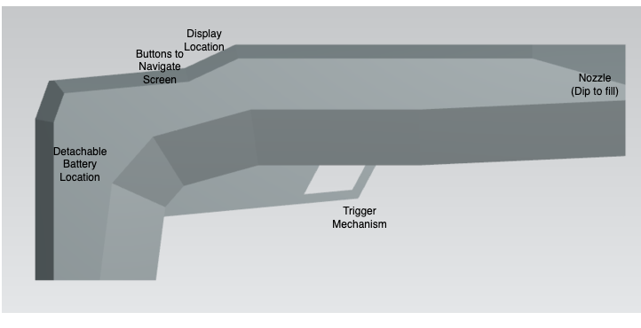
Visual Aid - Early CAD Model

Slide 5
High Level Requirements
The blaster should consistently shoot water bursts covering a distance of over 20ft.
The blaster must be light weight with a total weight not to exceed 10lbs.
The display must accurately reflect the state of the state machine and update in under 1 second to ensure accurate data is displayed.

Slide 6
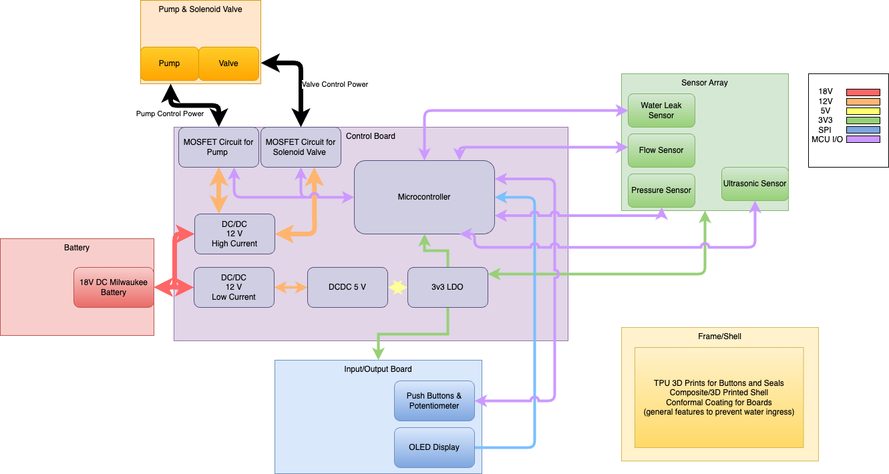
Block Diagram for water Blaster with 6 Subsystems

Slide 7
https://github.com/clarkmt2/ECE_445_WaterBlaster/tree/main
Github links

